Slide 1
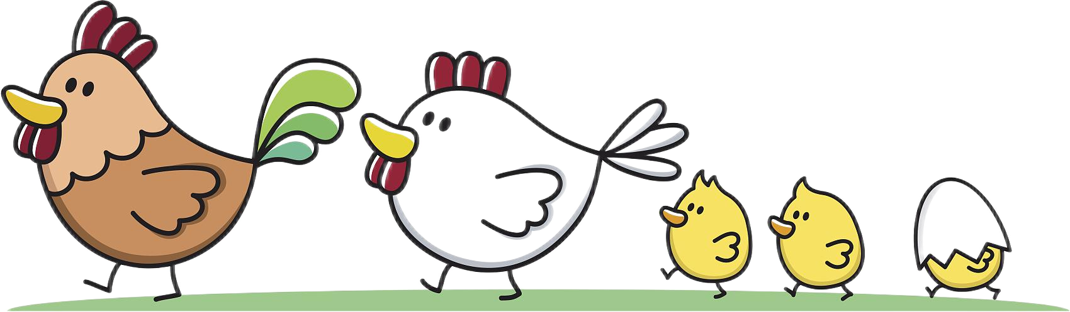
母鸡和小鸡

Slide 2
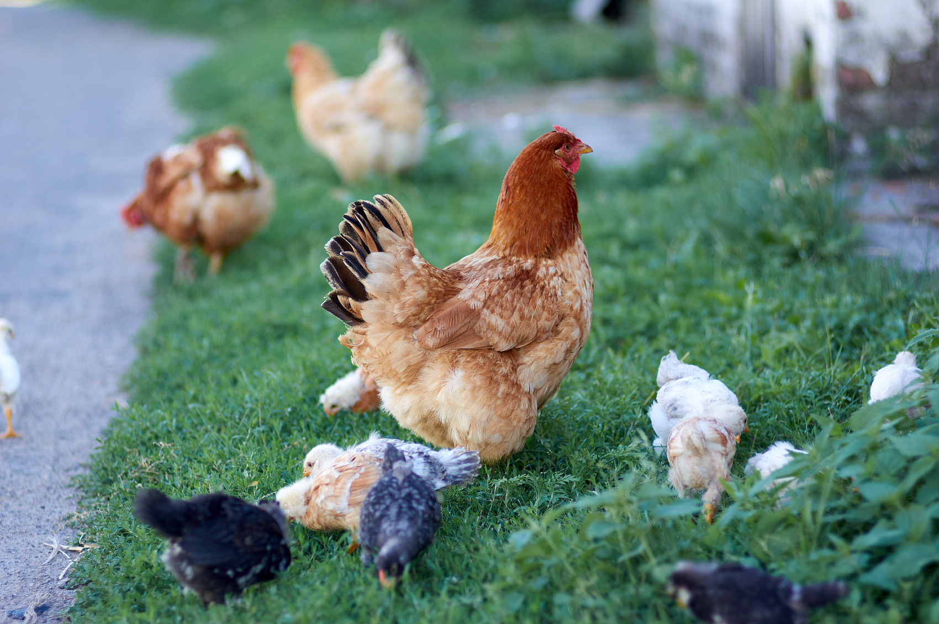

Slide 3
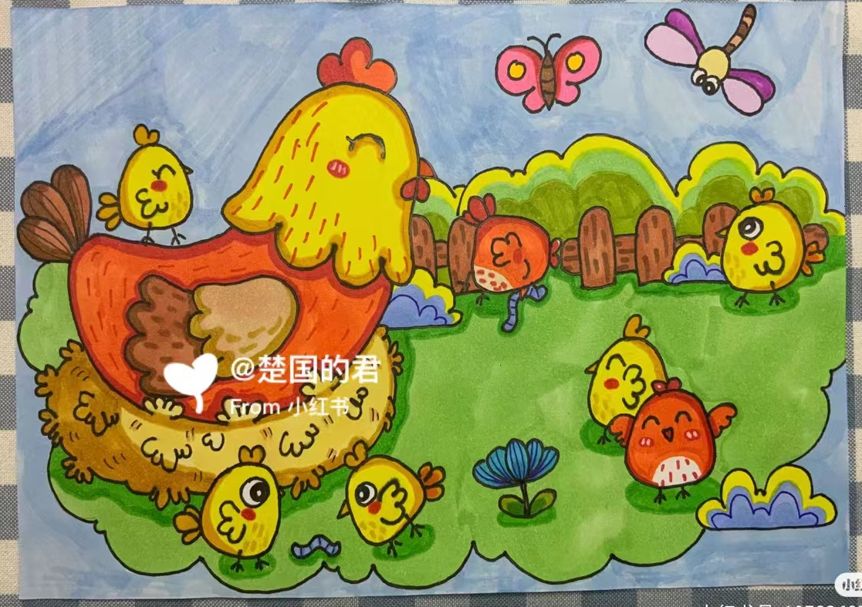

Slide 4
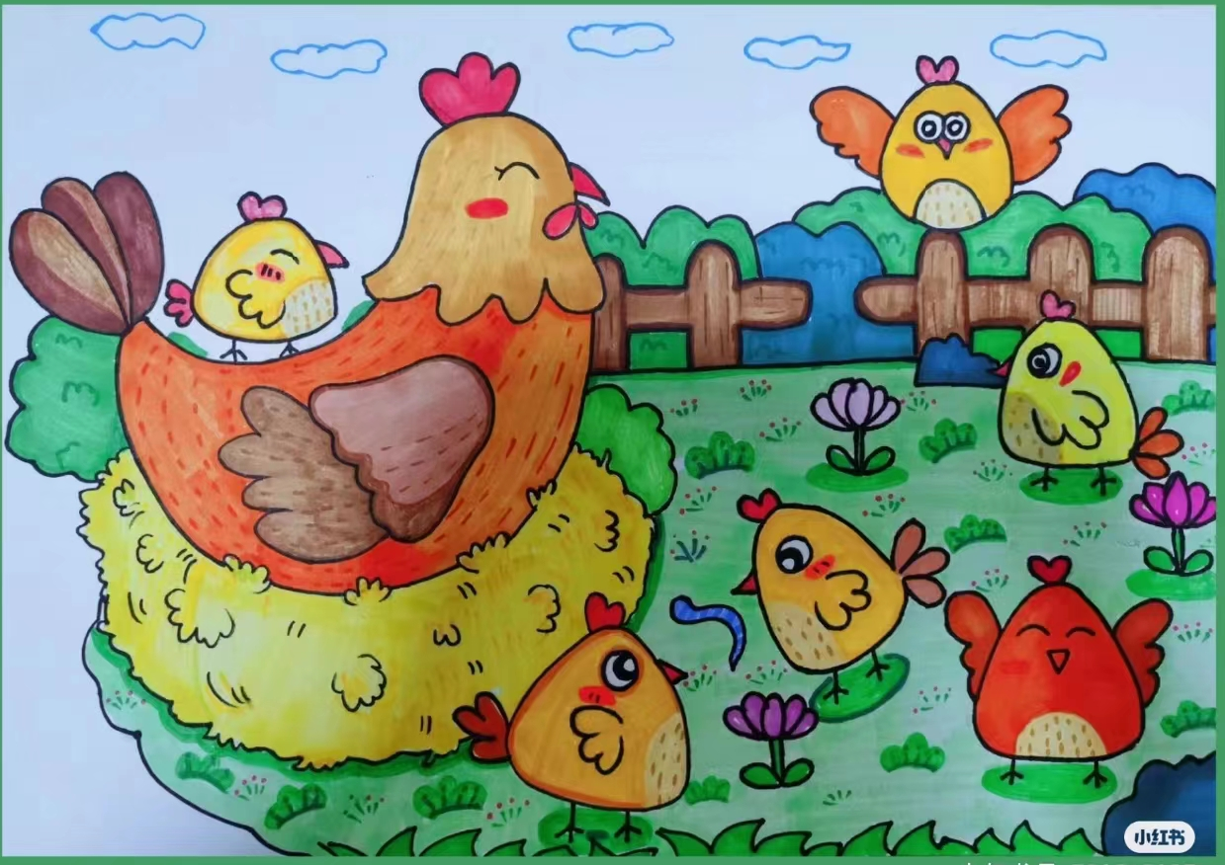

Slide 5
感谢观看
EDUCATION AND TEACHING

